Slide 1
Neural Networks
Why are GPU’s better than CPUs?
What GPU does vs What CPU Does

Slide 2
CPU
CPU Good at serial instruction processing; instructions that must be computed in sequence
Please Excuse My Dear Aunt Sally

Slide 3
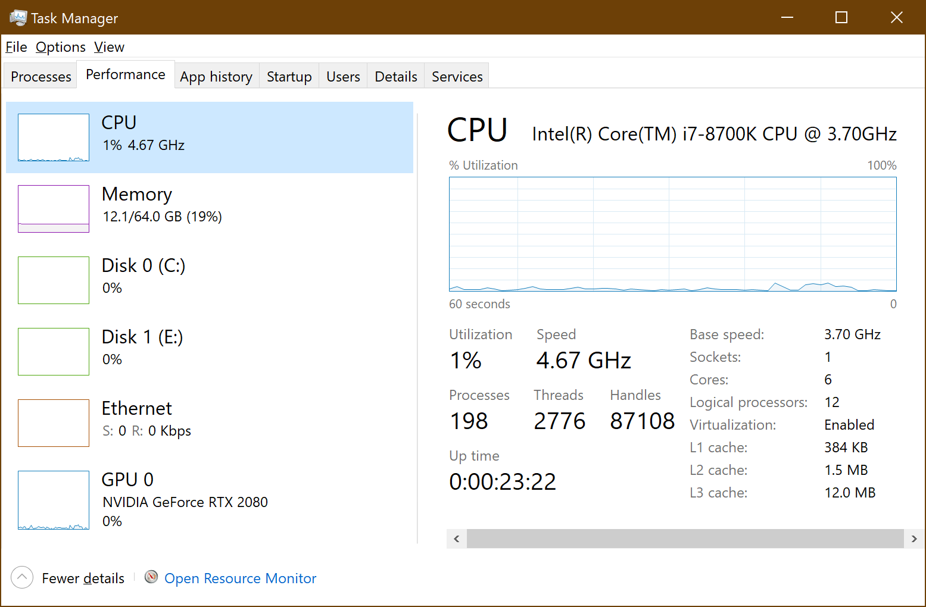
CPU Laymen Overview
Windows Task Manager:
Clock Speed
4.67 GHz
6 Cores
Relates to Hyperthreading; Different Discussion

Slide 4
Clock Cycles
4.67 GHz = 4,670,000,000 Clock Cycles Per Second
For this Discussion We Assume 1 Math Operation Executed per Clock Cycle

Slide 5
Serial Instruction Processing
This can easily be parallelized!
11 Math Operations = 11 CPU Clock Cycles
1 Core | Serial instructions:
Multiples of Bunnies = | 2*8*6*7*5*7*2*8*6*7*5*7=
1
2
Bunnies
553,190,400
3
4
5
6

Slide 6
Parallel Instruction Processing
We can easily parallelize instructions that can be processed independently
Here we use 1 clock Cycle:
1 Core | Serial instructions:
Multiples of Bunnies = | 2*8*6*7*5*7*2*8*6*7*5*7=
1
2
6 Cores | Parallel Instructions
Multiples of Bunnies = | 5*6=
Multiples of Bunnies = | 8*5=
Multiples of Bunnies = | 6*7=
Multiples of Bunnies = | 7*7=
Multiples of Bunnies = | 2*7=
Multiples of Bunnies = | 2*8=
30
40
42
49
14
16
3
4
5
6

Slide 7
Parallel Processing
We can easily parallelize instructions that can be processed independently
Here we use 5 more clock cycles: total = 6
1
2
Bunnies
553,190,400
1 Core | Serial Instructions
Multiples of Bunnies = | 40*14*30*42*16*49=
3
4
5
6

Slide 8
Not Always Easy to Parallelize
1 Core | Serial instructions:
Exponential Bunnies = | 2^3*2^4=
1
2
Bunnies
128
3
4
5
6
 | Serial instructions: | Bunnies
Mutations of Bunnies? | 2*3^2^4= | 13,122

Slide 9
GPU
Good at parallel instruction processing

Slide 10
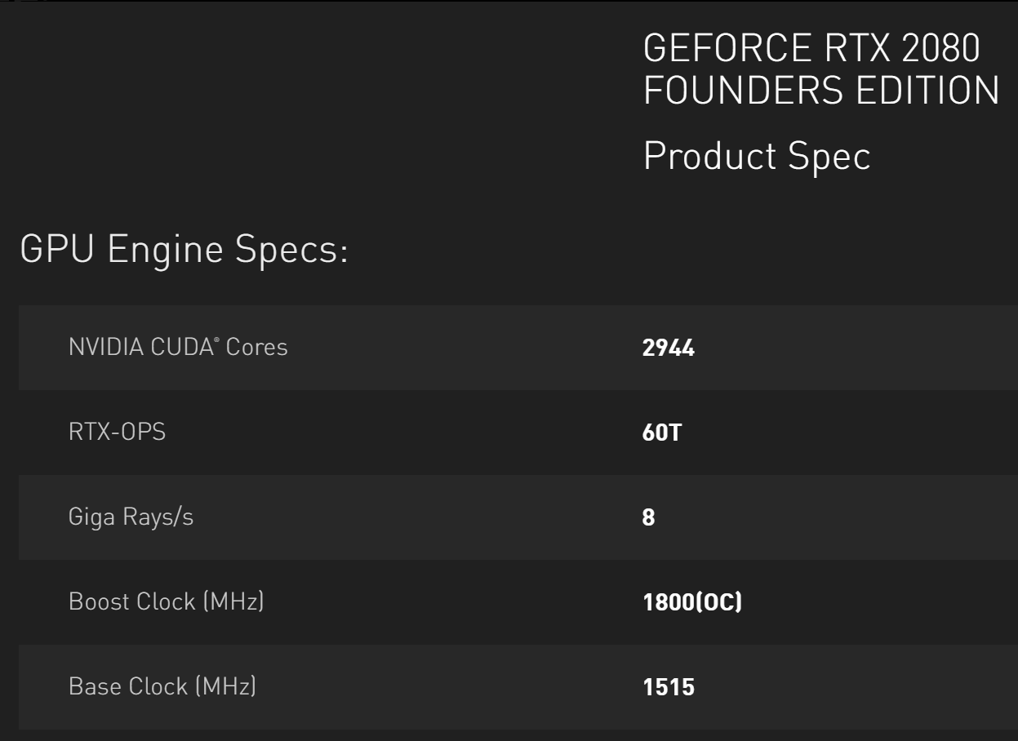
Nvidia Specs

Slide 11
GPU
1.515 GHz = 1,515,000,000 Clock Cycles Per Second

Slide 12
Why Not Make GPU 4.67 GHz?
Heat
Other things

Slide 13
Matrix Math
CPU (1 Core) Math Instructions = 1900 = 1900 Clock Cycles
(Our way, This Way) GPU Math Instructions = 1900 = 600 Clock Cycles (And Can Still Be Less if we really Worked at it)

Slide 14
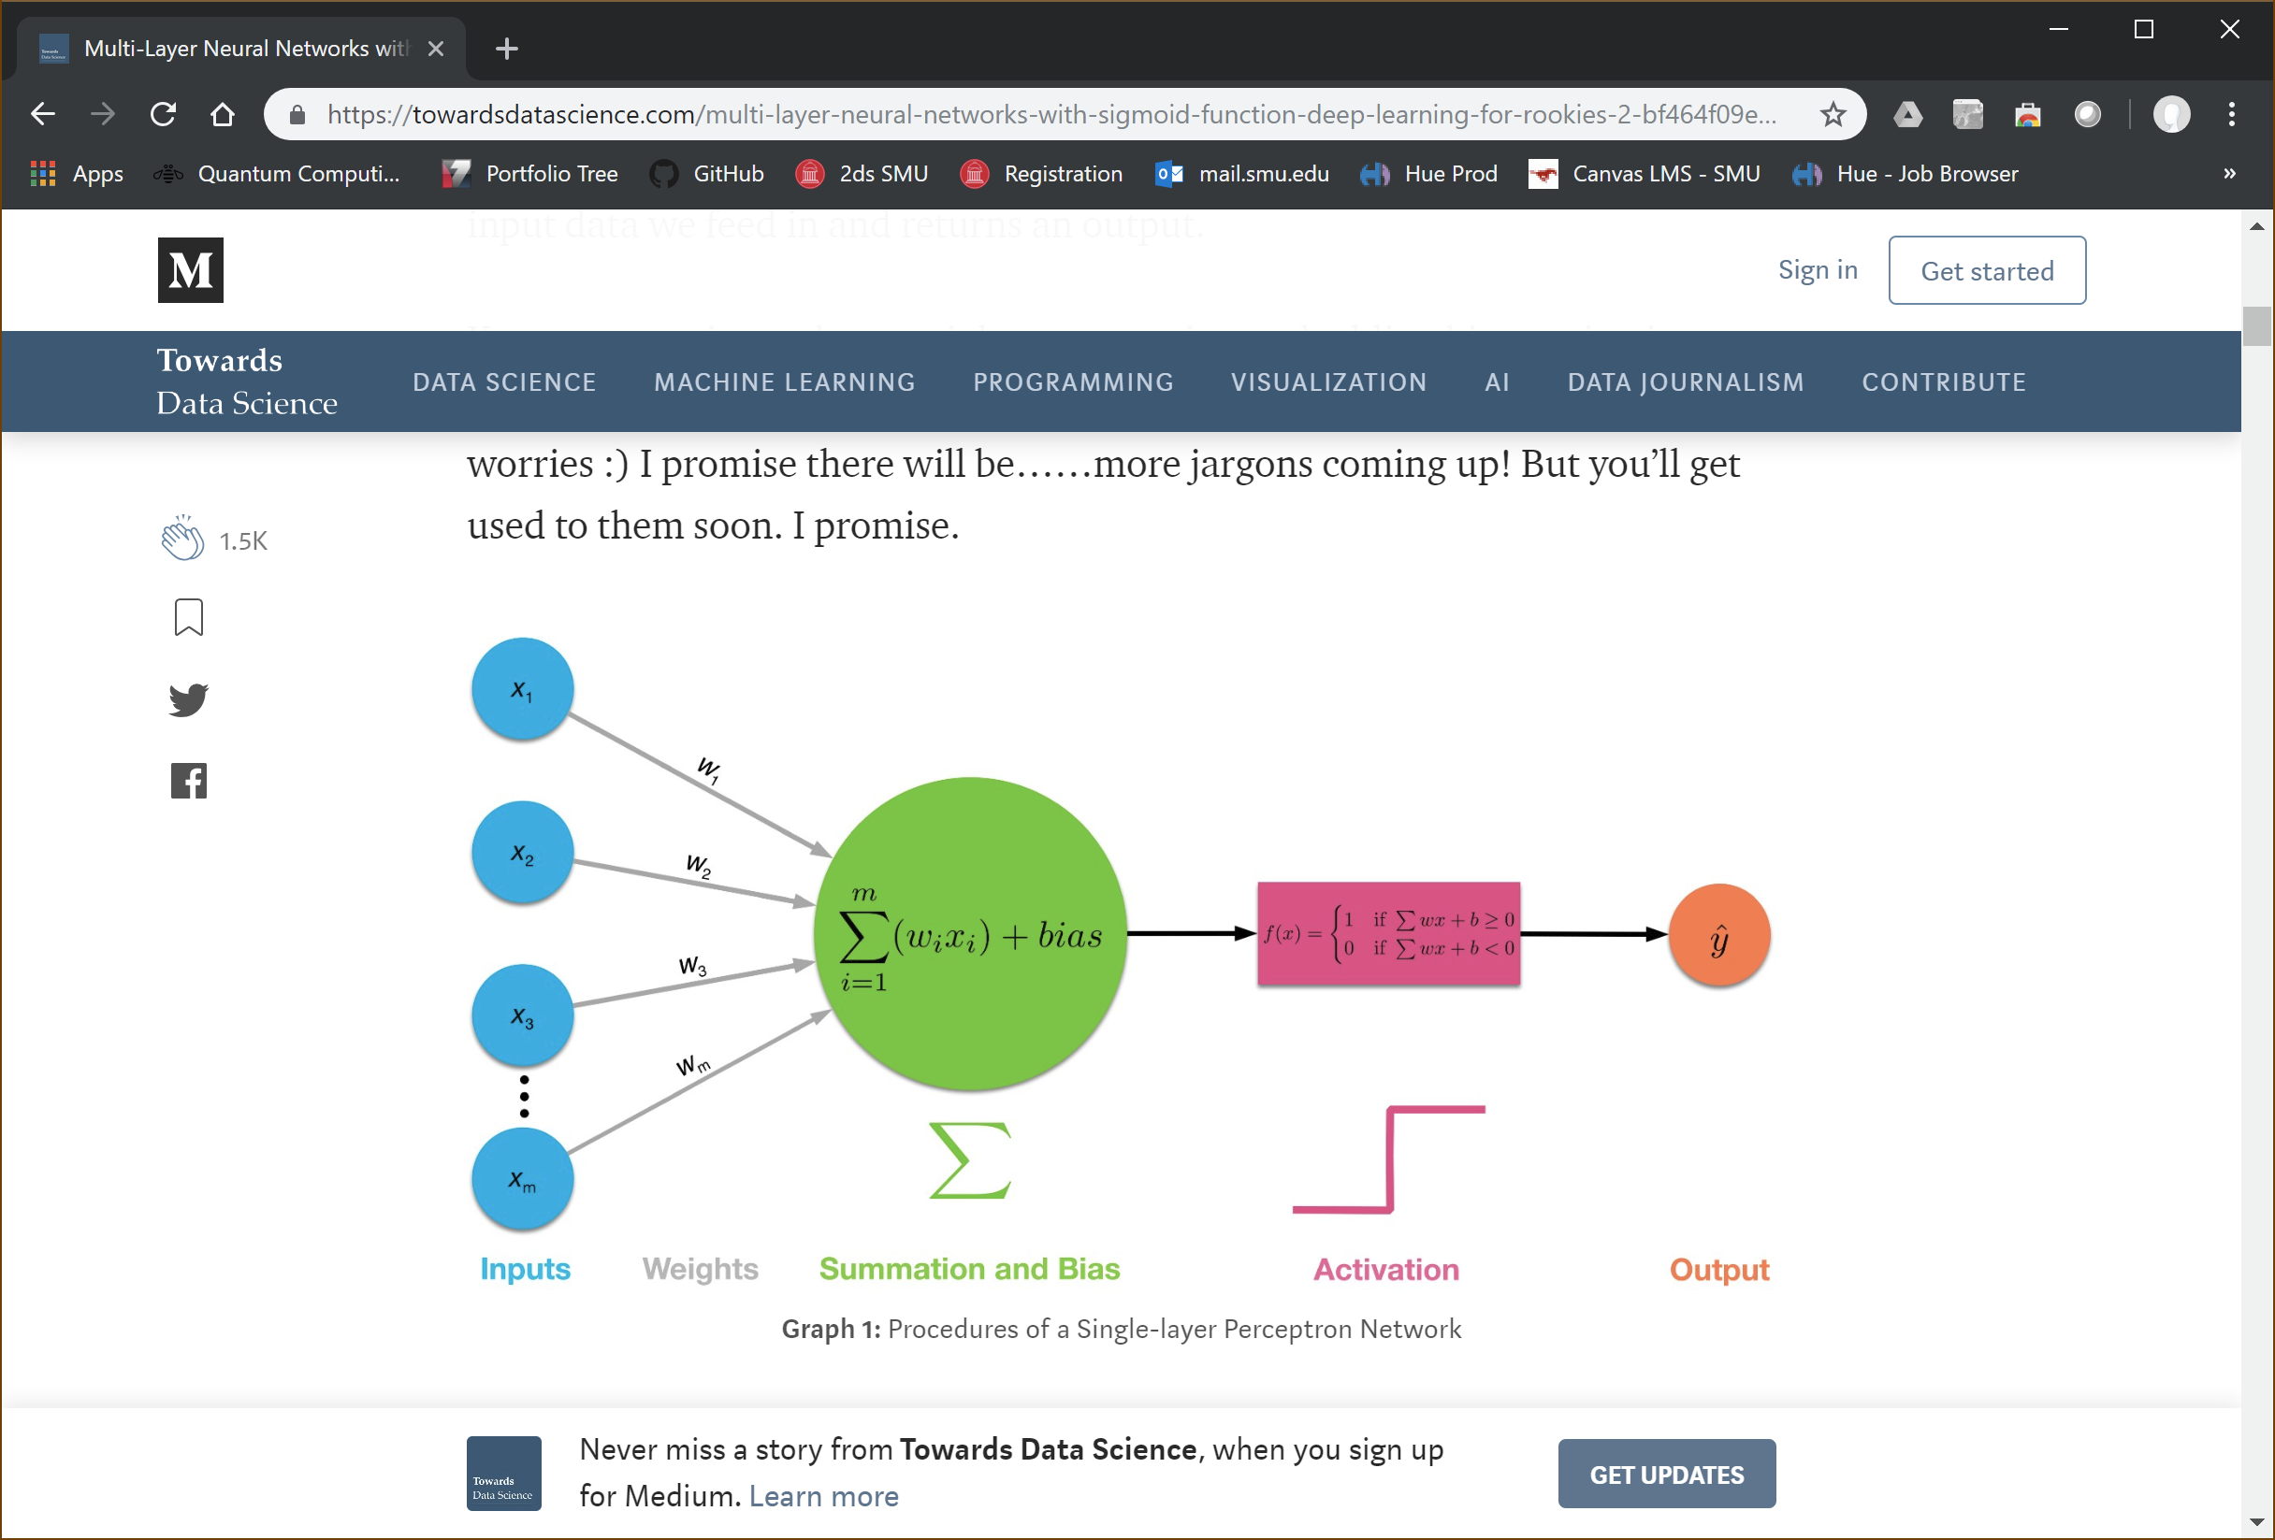

Slide 15
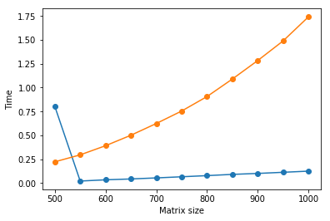
Copied from Erik Hallström https://medium.com/@erikhallstrm/hello-world-tensorflow-649b15aed18c

Slide 16
There’s More to It
Transfer Data from CPU and System Memory to GPU and GPU Memory
Transfer Results Back From GPU To CPU and System Memory/Disk
In this discussion we are oversimplifying

